Slide 1
Benchmarking Project: Taxator-Tk
Nicole Buleza, Anna Lu, Keyur Shah
ECEST480/680 Winter 2017

Slide 2
Workflow
Three stages
The first stage uses a local sequence aligner to identify similar regions from a reference sequence collection, such as microbial RefSeq (mRefSeq)
At the beginning of the taxator algorithm in Stage 2, overlapping regions on the query, each defined by local alignment to a nucleotide reference sequence, are merged into larger subsequences called segments. These query segments are flanked by regions without similarity to any reference data and are not considered further.
This step reduces the overall number of positions in the following alignment computations and improves the taxonomic assignment of queries that have undergone genome rearrangements, resulting in a different order of these segments.
In the third stage, multiple segments belonging to the same query are considered and their IDs are combined in the program binner, to derive a consensus taxon ID.
Notes:
Anna

Slide 3
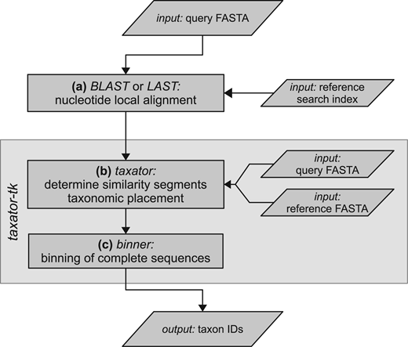
Workflow
Both -f ref.fasta -g mapping.tax from sample refPack
Notes:
Anna

Slide 4
Takator-TK RPA Algorithm
RPA - realignment placement algorithm
Two pass method for taxonomic assignment
RPA: Use the LCA of taxa of a dynamic set of reference segments as determined by the ordering of pairwise scores of alignments
LCA - Lowest Common Ancestor
Notes:
Keyur

Slide 5
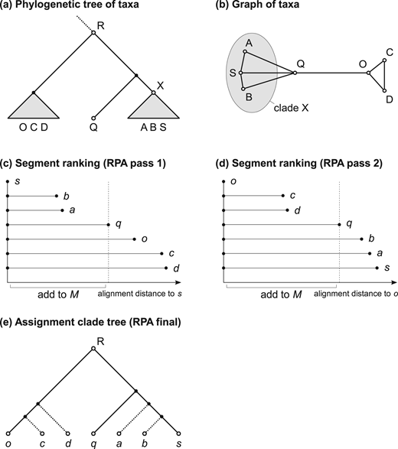
Taxator-Tk RPA Algorithm
Fast nucleotide alignment using edit distance
<= dist(s,q)
Outgroup, o as 1st segment.
All segments aligned to o
<= dist(o,q)
Notes:
Keyur

Slide 6
Benchmarking Binning Results
@@SequenceID TaxID _TaxatorTK_Support _TaxatorTK_Length
No bins produced
Notes:
Anna

Slide 7
Evaluation of Tool
Process Step | Time | File size
Load input data.fna | ~minutes
Load mapping.tax | ~5.5 hours
Binning with RPA | ~minutes
Notes:
Anna

Slide 8
Summary
Taxator-Tk uses LCA -- similar to MEGAN
(MEGAN)-LCA only requires one reference alignment file
RPA requires two references for corresponding scores
alignment file + reference fasta from refpack
Sensitive Method for taxonomic labeling
Requires at least two homologous segments (s and o)
Our group is working towards binning output
Currently ⅚ issues resolved
Notes:
Nicole

Slide 9
Project Challenges
1 Binner segment fault bug
Issue: https://github.com/fungs/taxator-tk/issues/54
Resolution: give an input flag -n sampleid to binner
binner -n 1 ...
2 No mapping file
issue: file not found exception
Resolution 1: provide mapping.tax from sample refpack
Resolution 2: build custom reference mapping file
Notes:
Nicole

Slide 10
Project Challenges
3 No reference file
issue: file not found exception
resolution: Taxator provides the refpack including the secondary input reference FASTA for RPA -f ref.fna
4 Multi-threading exception
issue: https://github.com/fungs/taxator-tk/issues/51
resolution: did not multi-thread, removed flag -p "taxator ... -p 3"
5 Alignment formatting bug
issue: https://github.com/fungs/taxator-tk/issues/53, https://github.com/fungs/taxator-tk/issues/52
resolution: added a tab to the end of every line in .blast alignments file
sed -i 's/$\t/' "$filename.blast"

Slide 11
Project Challenges
6 bad taxon mapping
issue: bad taxon mapping for alignment reference sequence
resolution: no resolution
Attempted resolutions:
Appended sseqid taxids to provided mapping.tax file
custom mapping.tax provided with format sseqid taxid

